Slide 1
WordPress Web Application Deployment
PROJECT-2
By
Rajesh Pattapu

Slide 2
Deploying WordPress with AWS RDS and EC2:
METHOD-1
- Create an RDS instance with MySQL
- Launch EC2 instance with Amazon Linux
- Install Apache web server and MySQL client
- Connect EC2 to RDS and configure WordPress

Slide 3
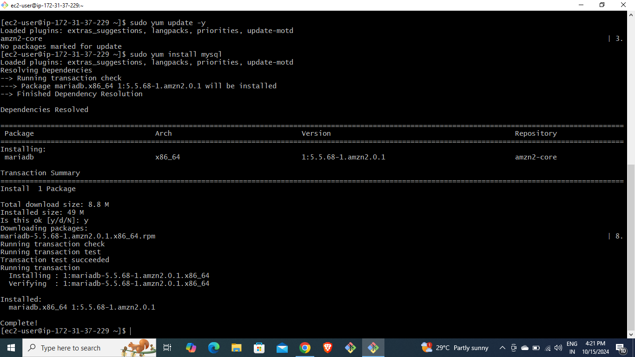
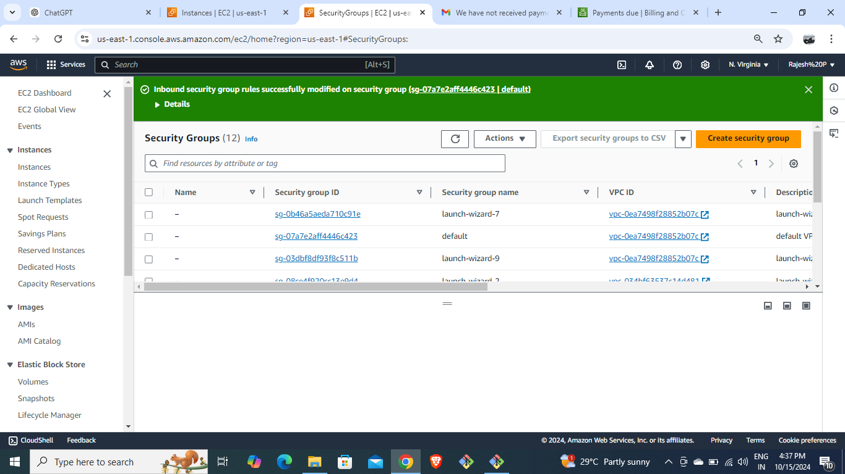
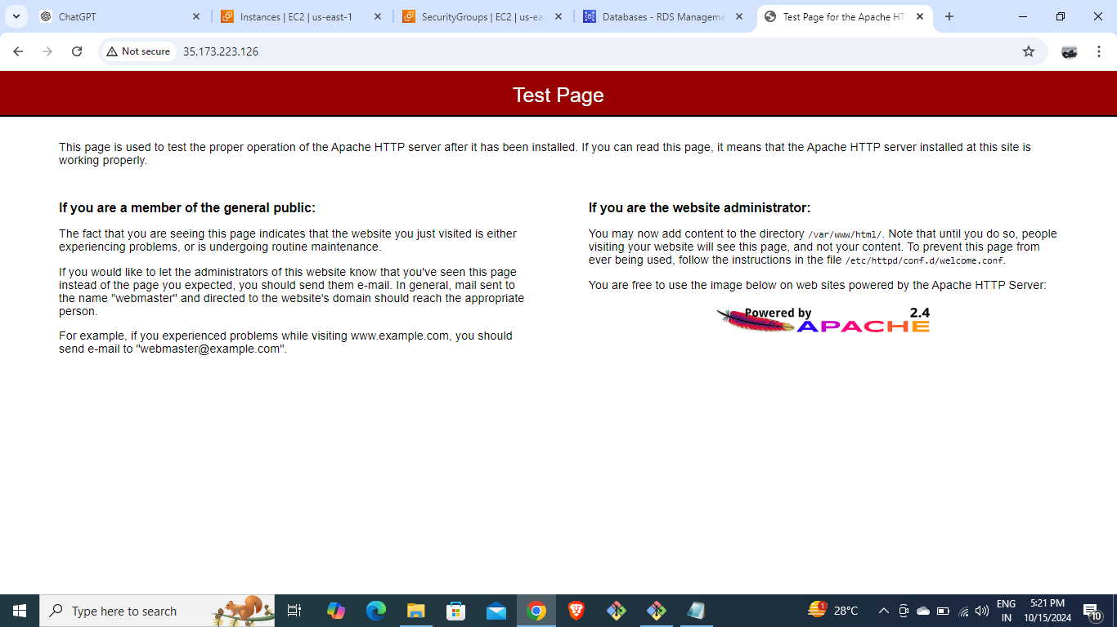
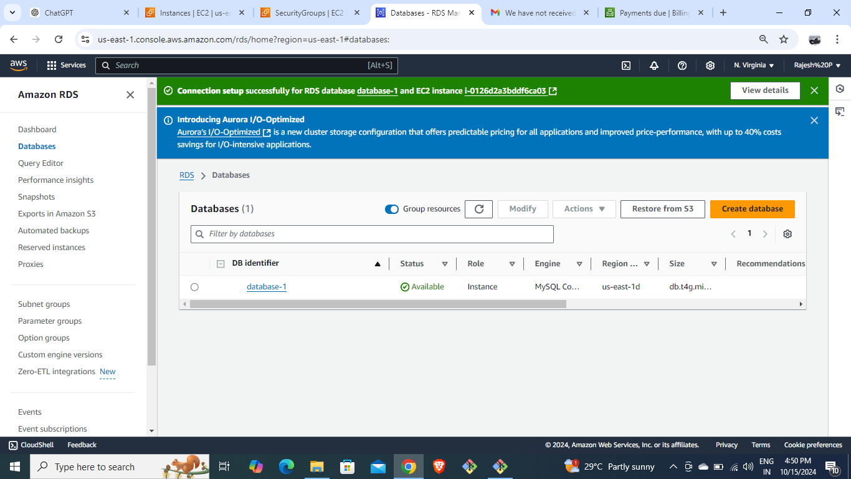
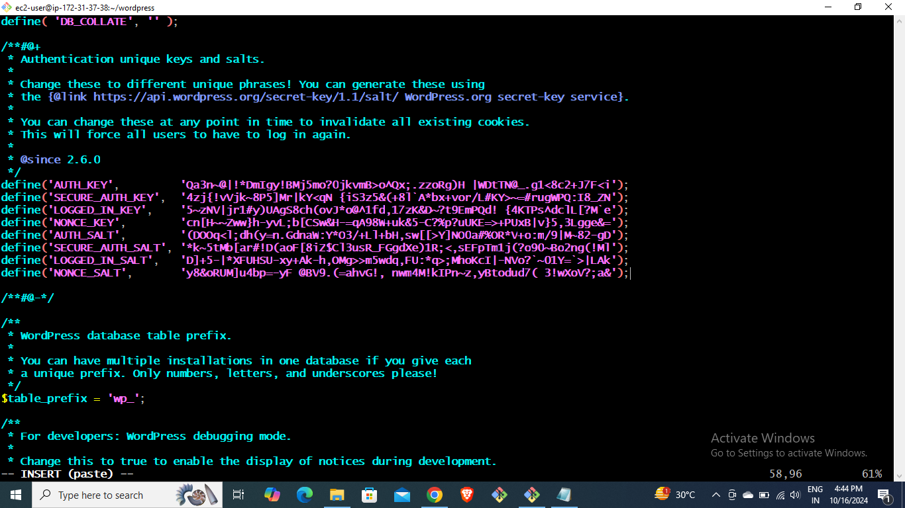
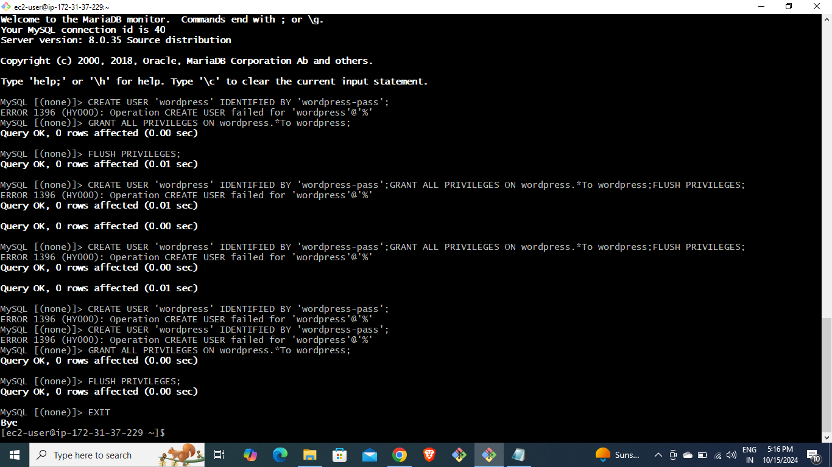
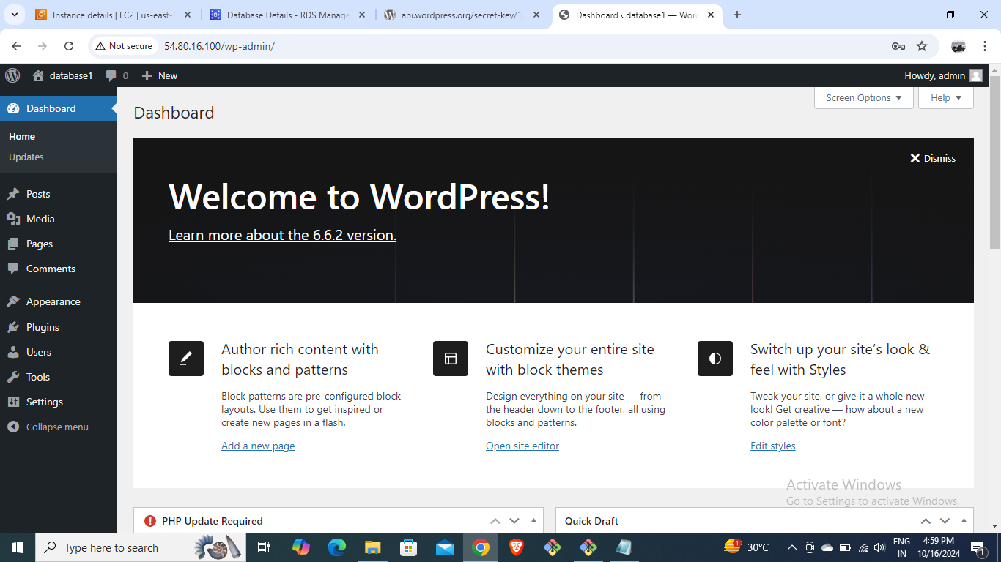
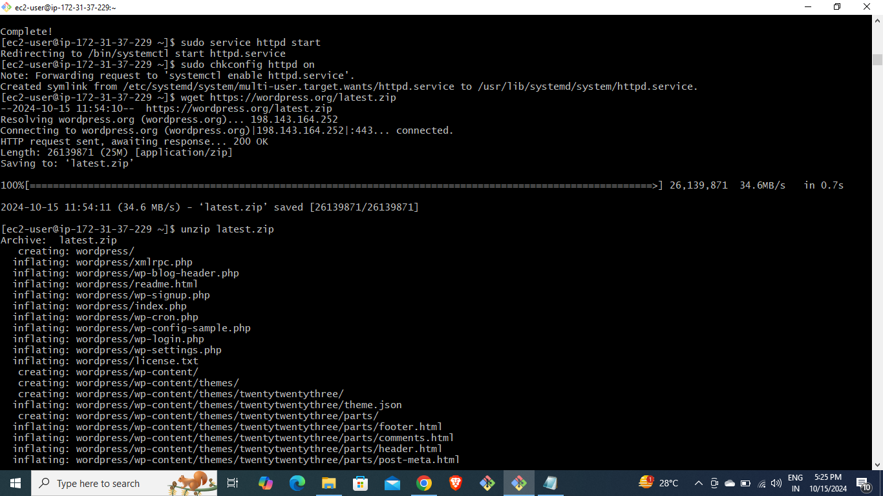

Slide 4
WordPress Deployment with Docker :
METHOD-2
Install Docker on EC2 instance
Use Docker Compose to pull MySQL and WordPress images
Launch WordPress application with Docker

Slide 5
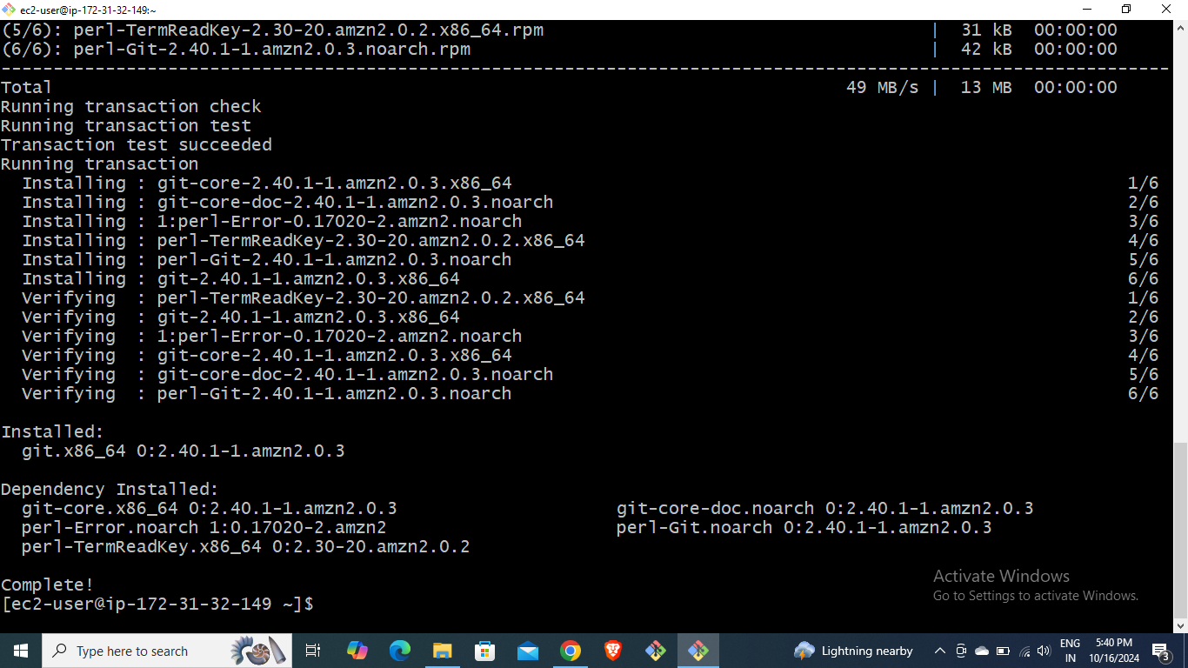
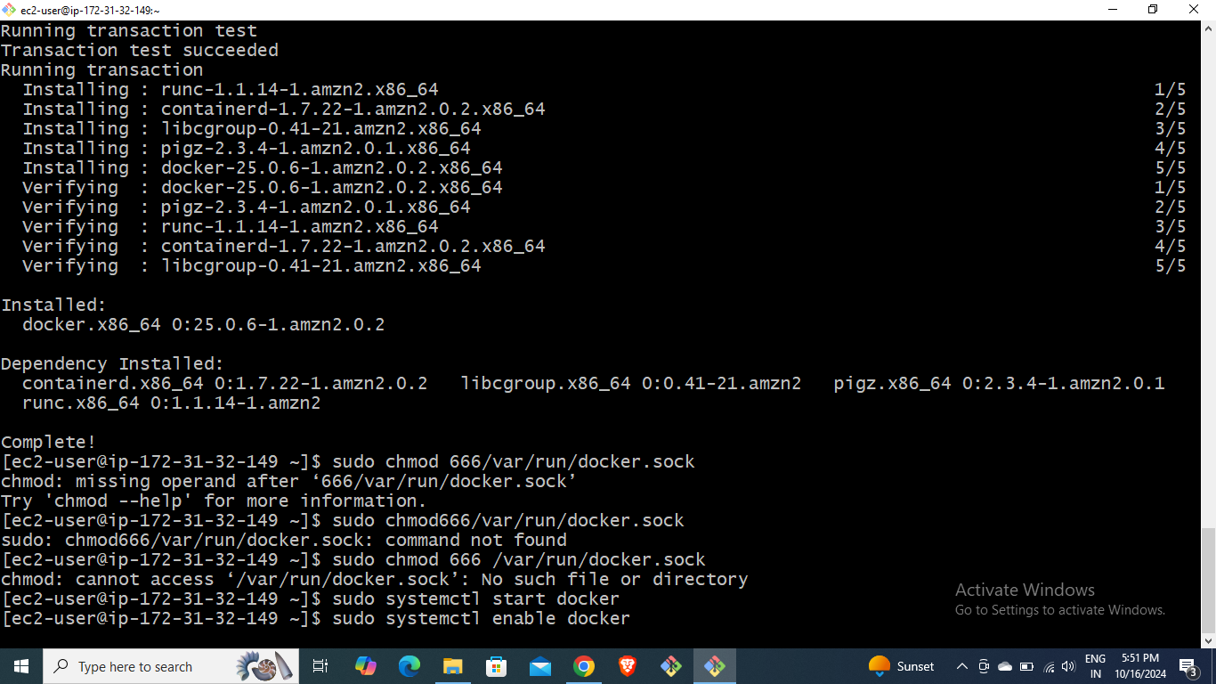
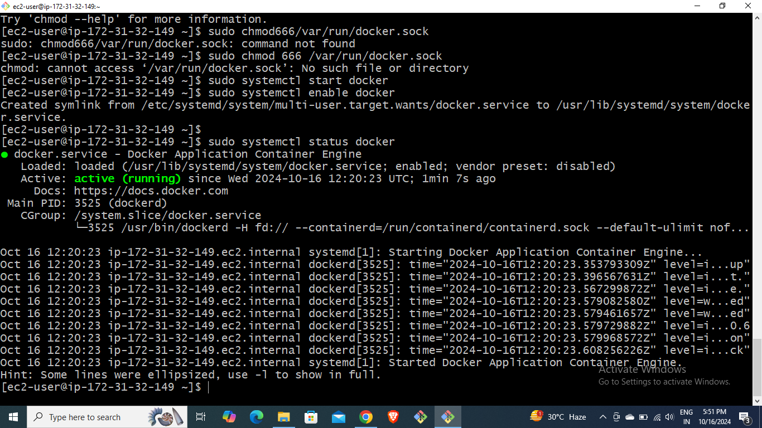
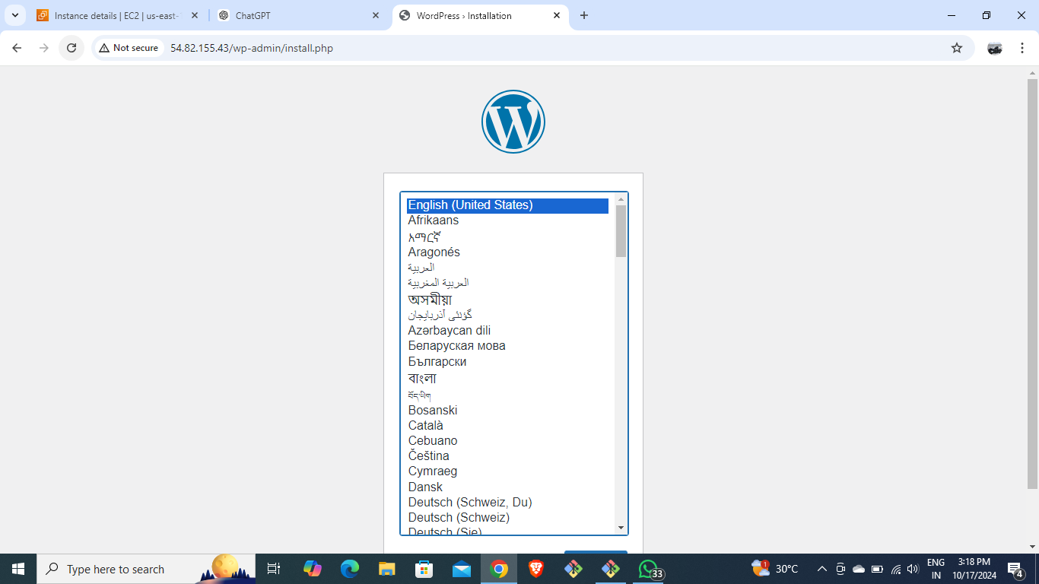
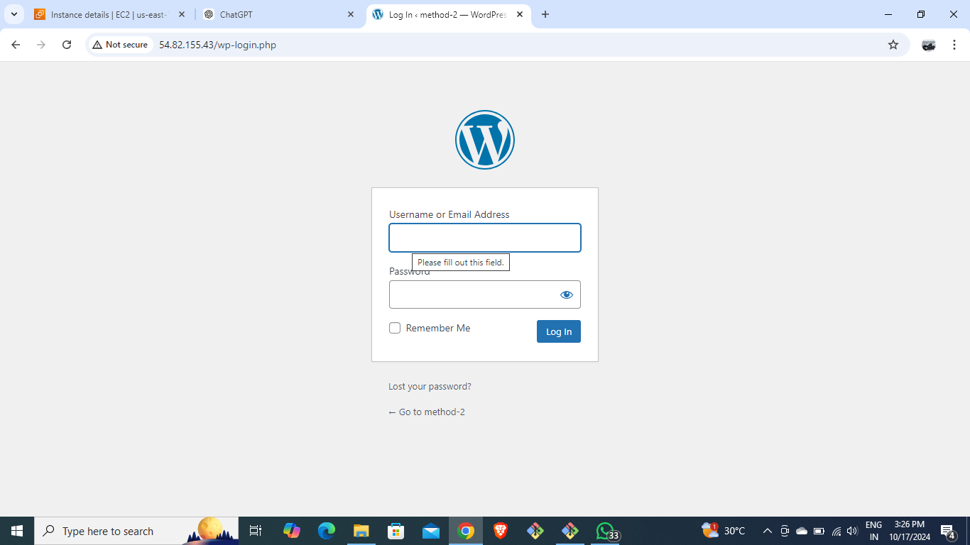


Slide 6
Using Jenkins and Git for WordPress Deployment and also with the execute shell :
METHOD-3
Create EC2 instance and install Jenkins
Clone WordPress repository using Git
Configure Jenkins job to deploy WordPress
Write the bash script in execute shell.

Slide 7
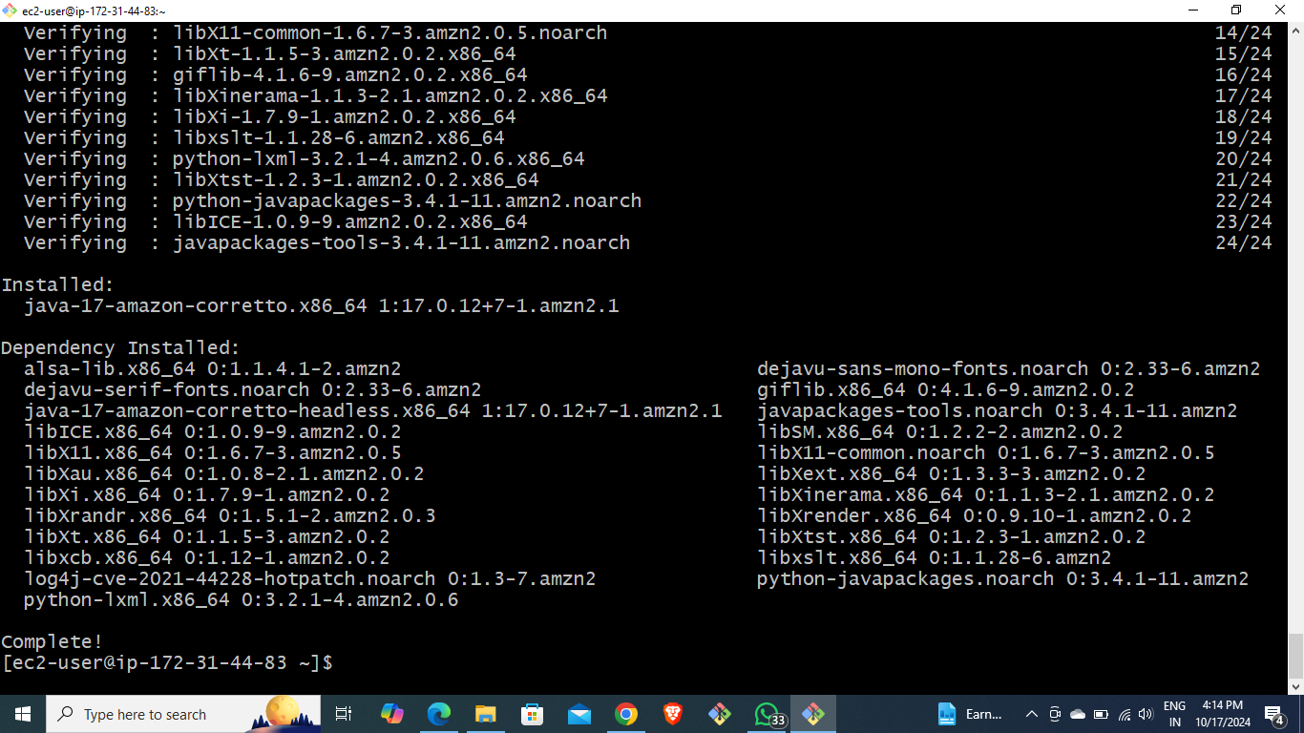
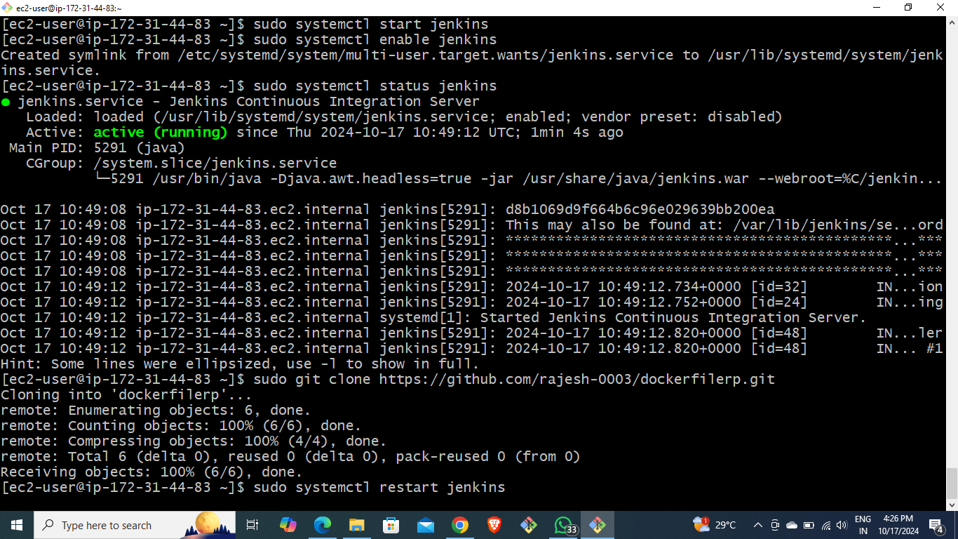
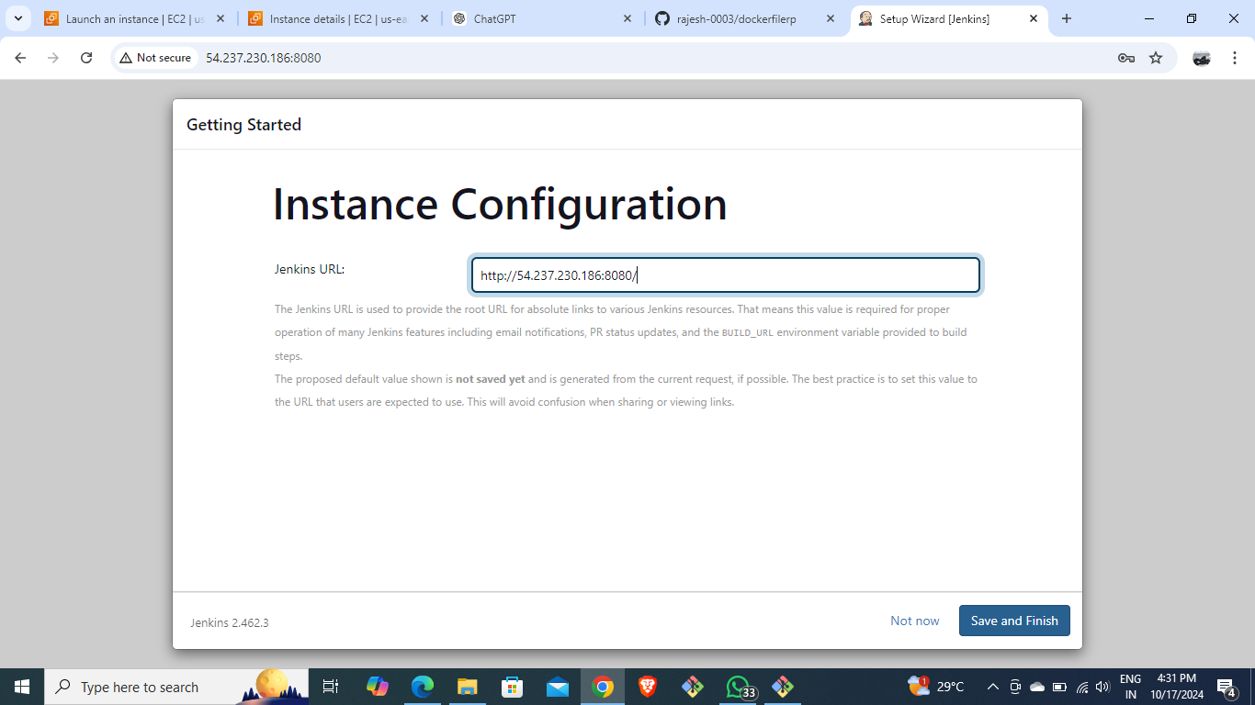
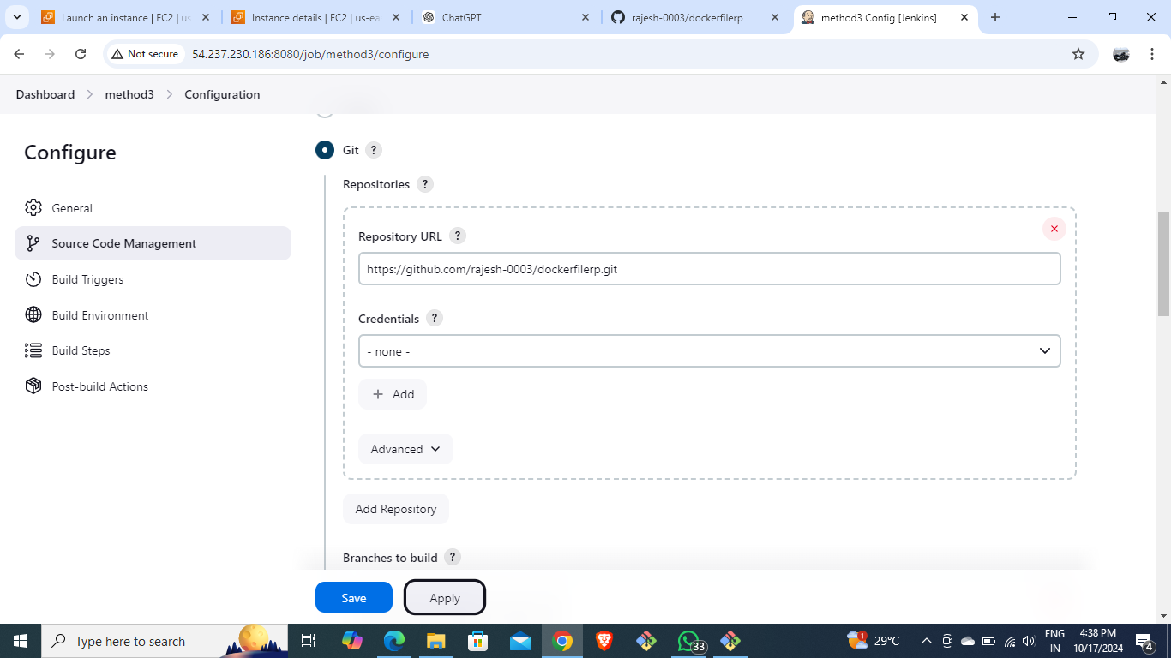

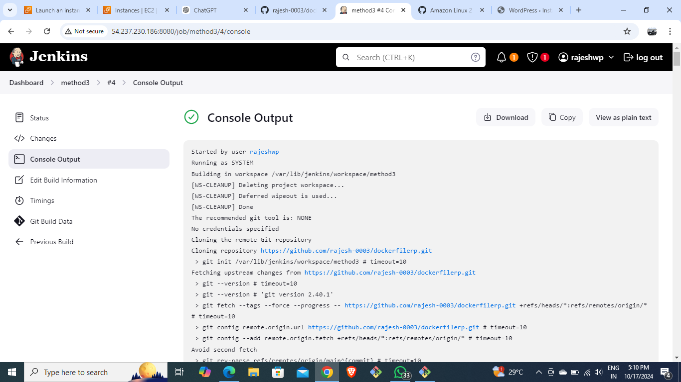

Slide 8
Deploying WordPress with EC2 User Data:
METHOD-4
-Create EC2 instance with t3.micro
- Configure security groups for HTTP, HTTPS, SSH
- Use bash script in User Data to install WordPress

Slide 9
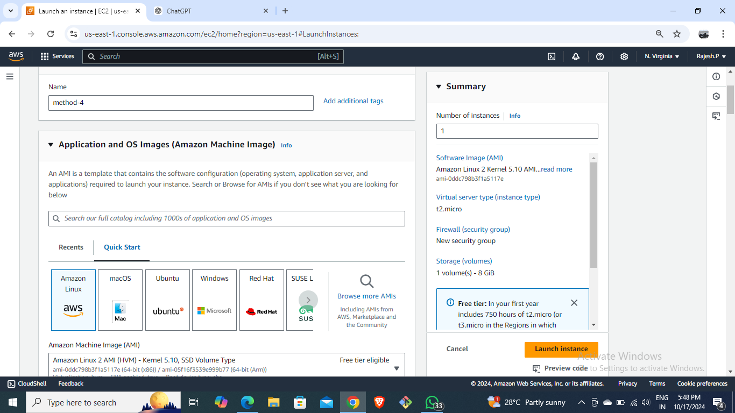
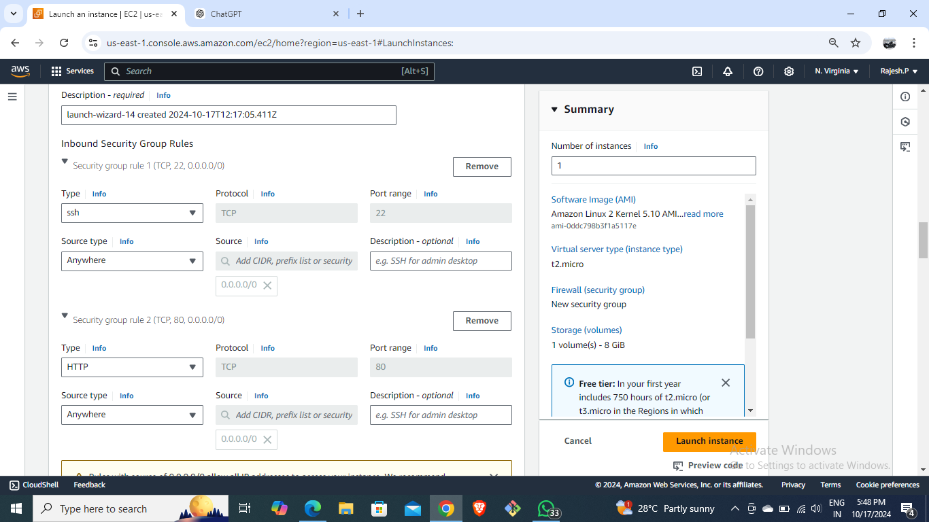
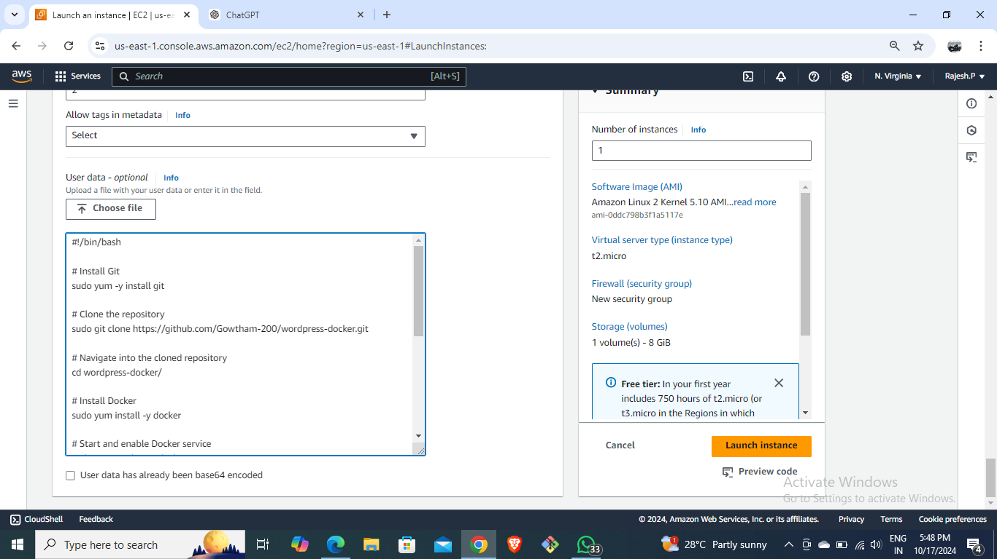
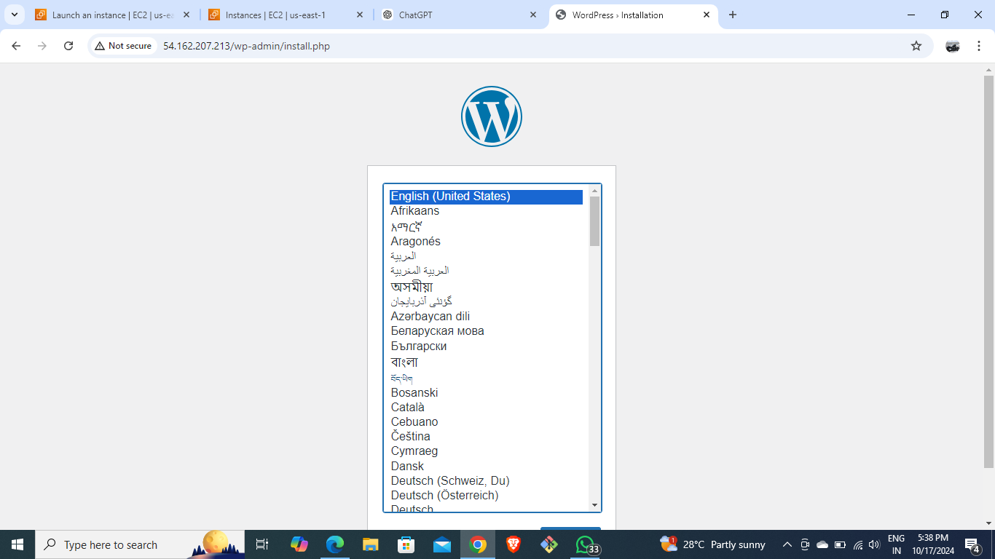
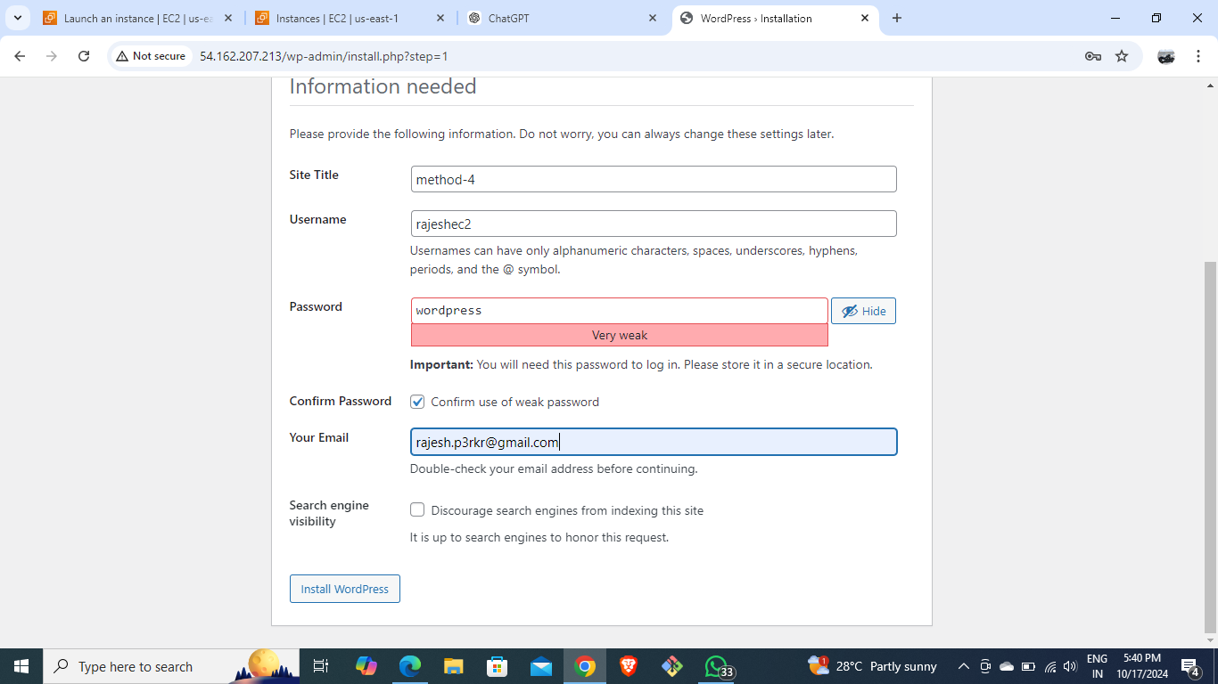


Slide 10
METHOD-5
DEPLOY WORDPRESS USING GIT AND JENKINS EXECUTE SHELL:
Launch an instance and install jenkins and then start and enable it.
Copy public Ip of instance to view Jenkins and create a new job & write bash script in Jenkins execute shell.
Build the created job.
Copy the public Ip of instance to view the WordPress application.

Slide 11
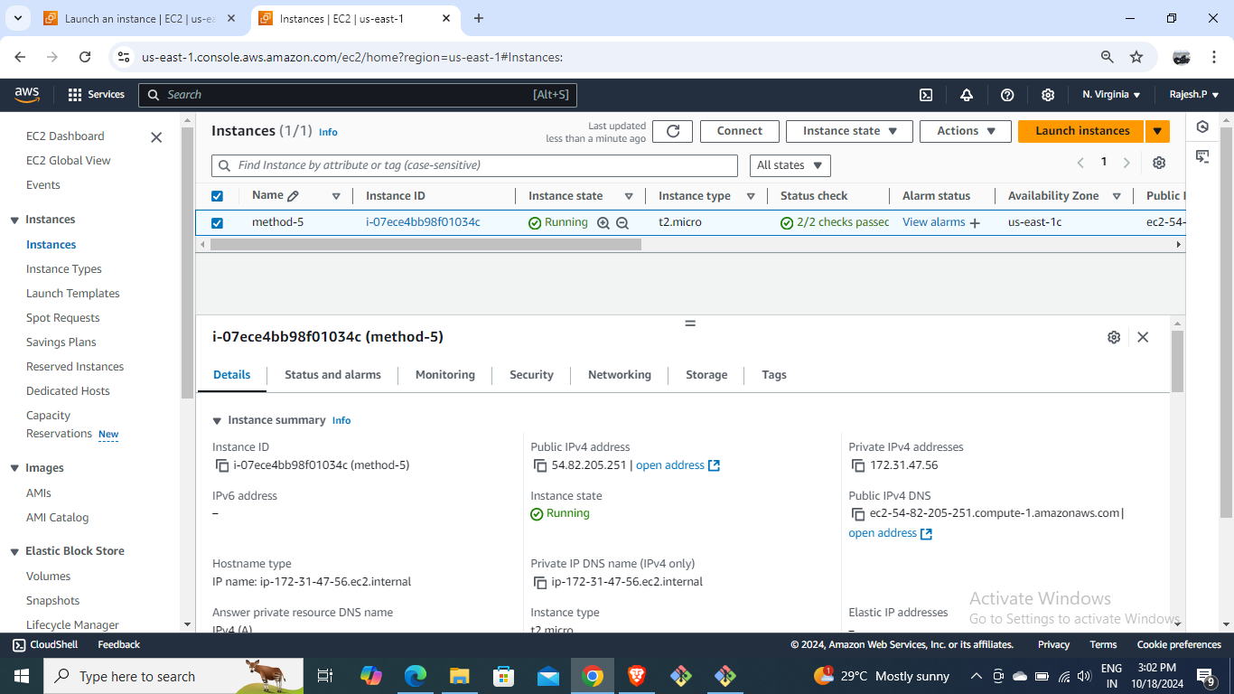
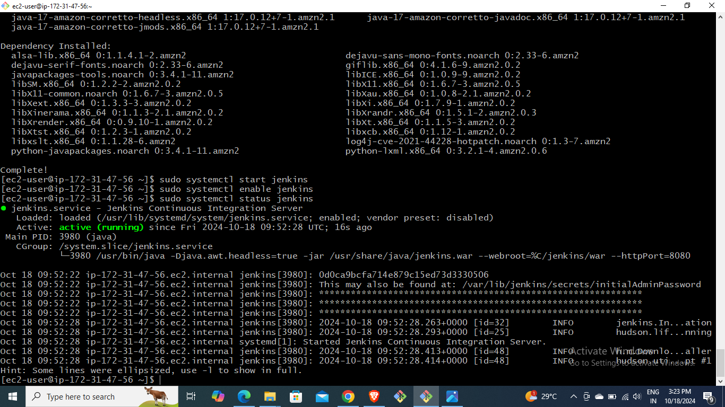
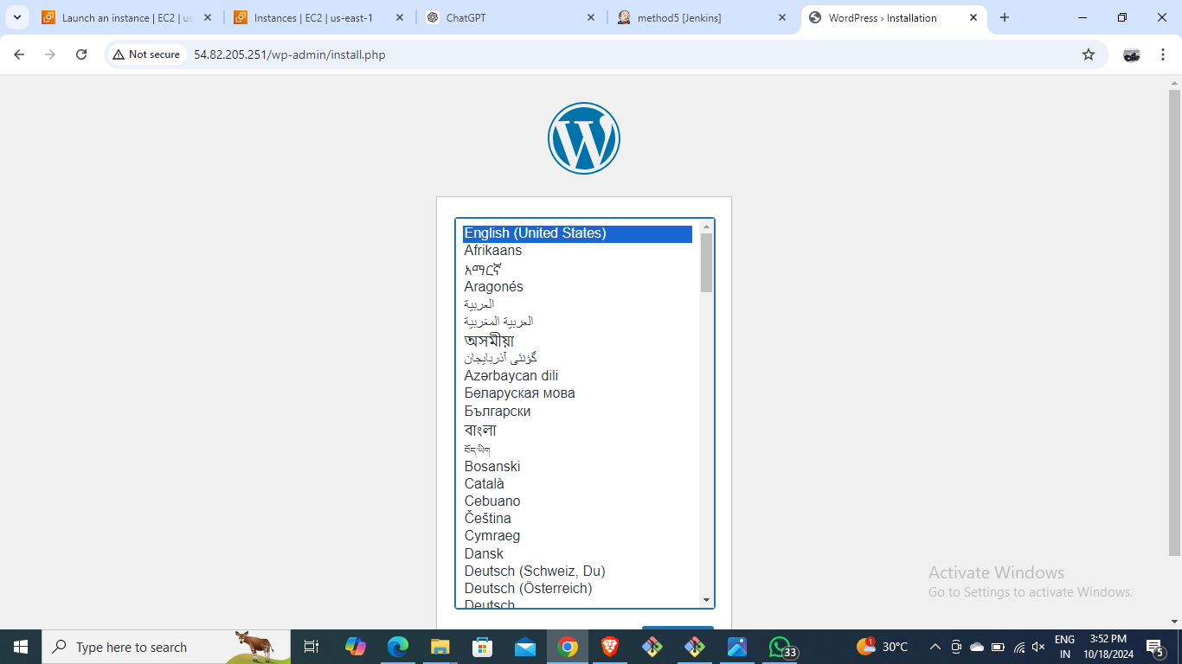
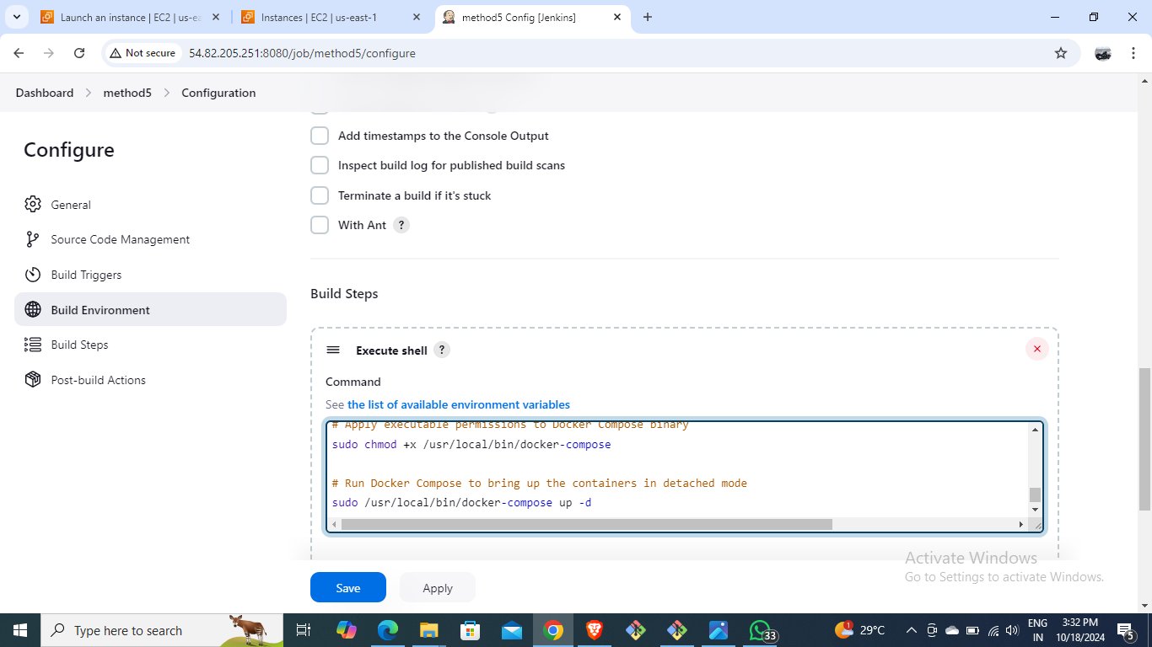
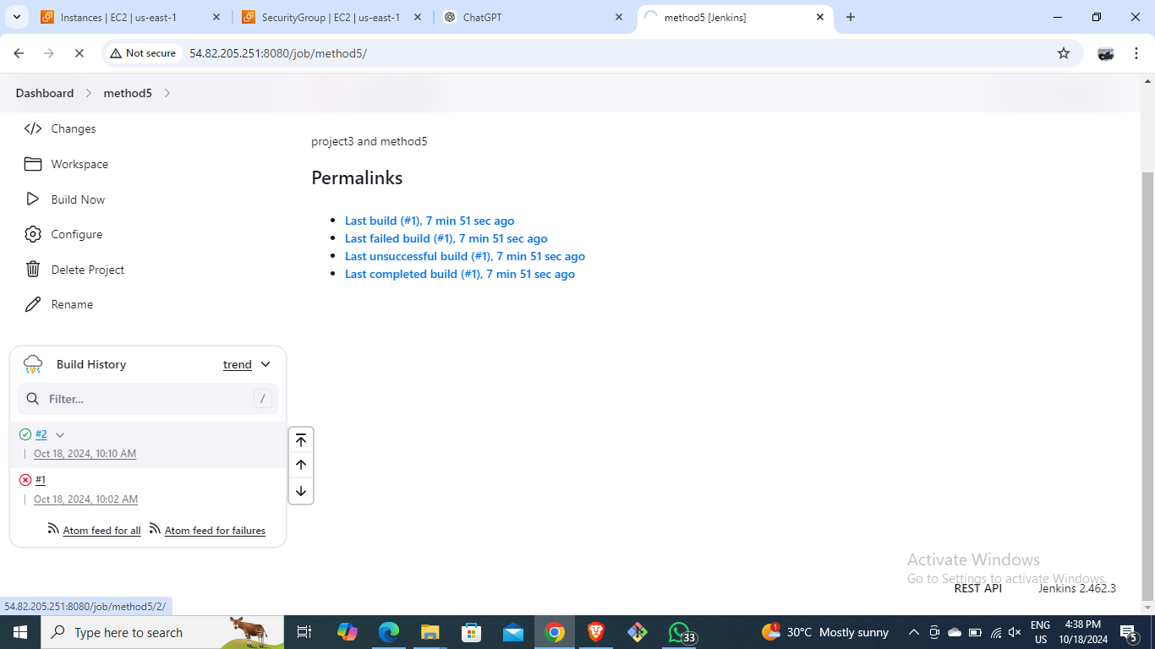
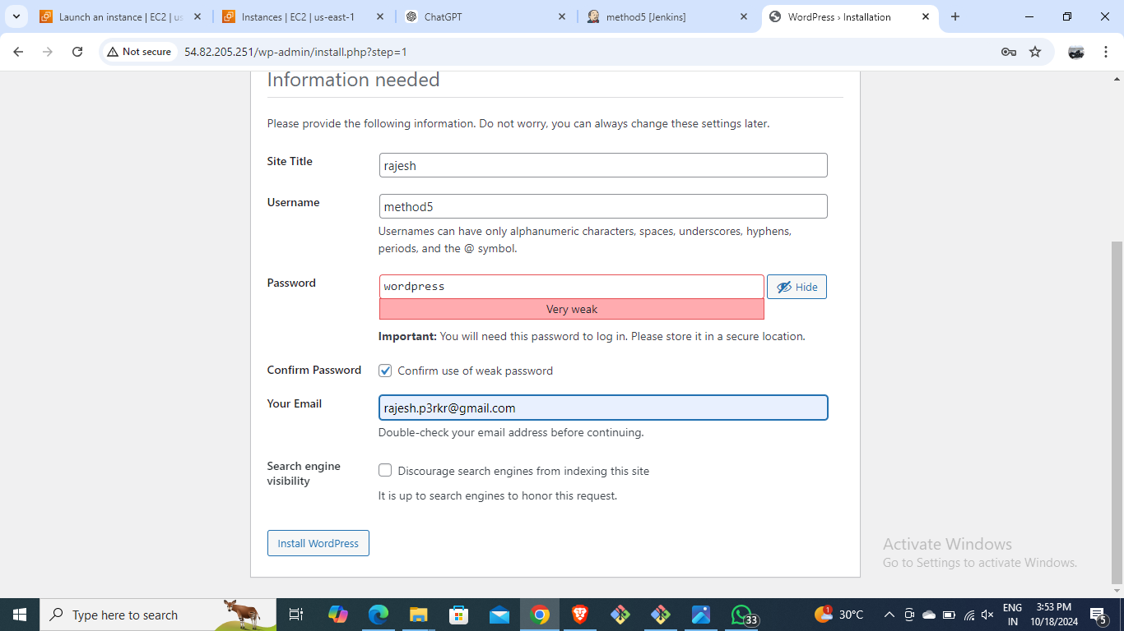

Slide 12
Deployment with jenkins pipeline add build periodically and poll scm:
METHOD-6
Create EC2 instance and install Jenkins
Clone WordPress repository using Git
Configure clone job and build job to deploy WordPress
Write the bash script in execute shell in build job.
Install build pipeline plugin and build new view.
Put initial job as clone job and postbuild action as build job and set the schedule for build periodically build that and observe than set the schedule for poll scm before that changes in the script and run observe the output of poll scm.

Slide 13
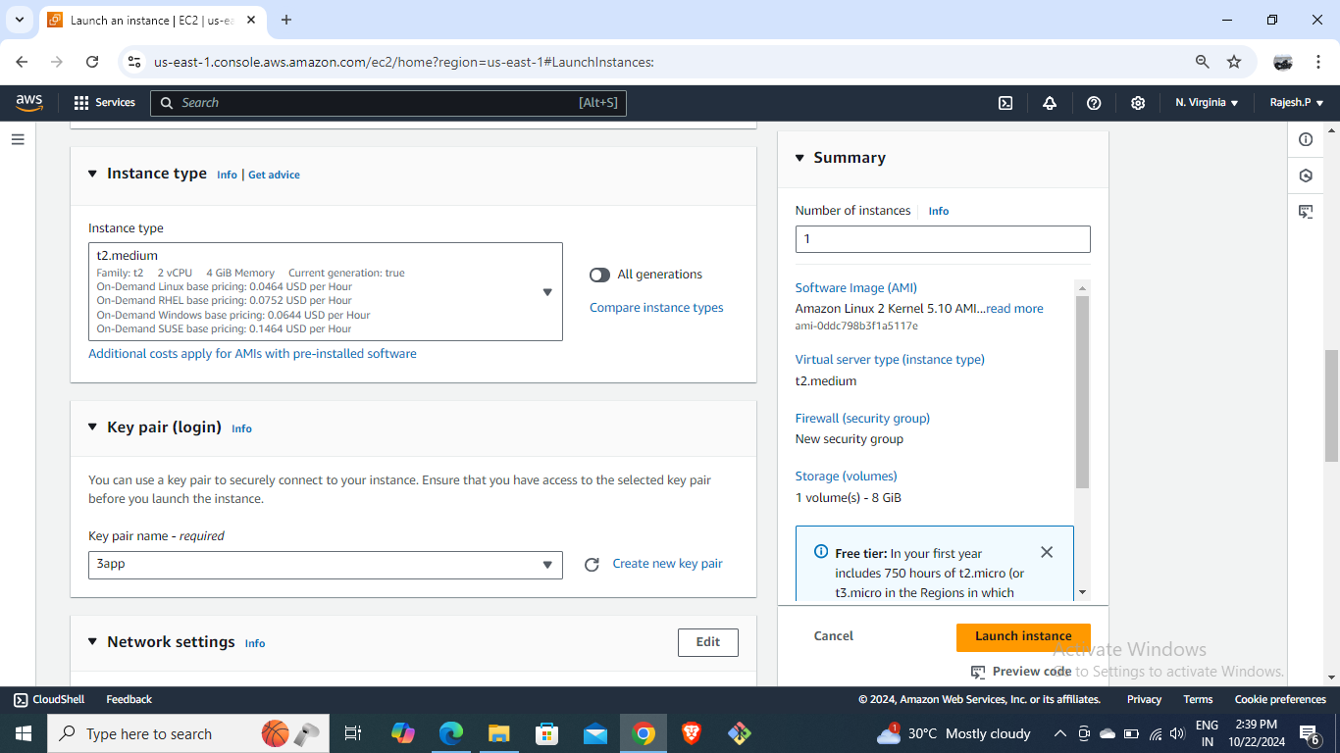
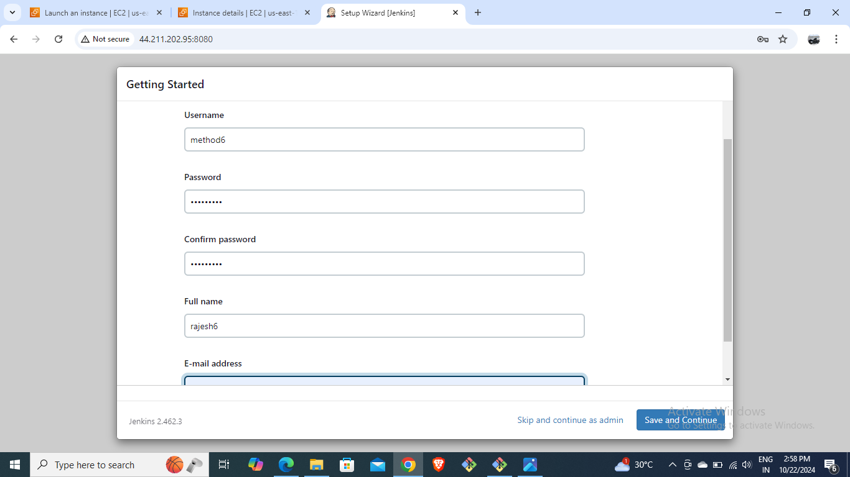
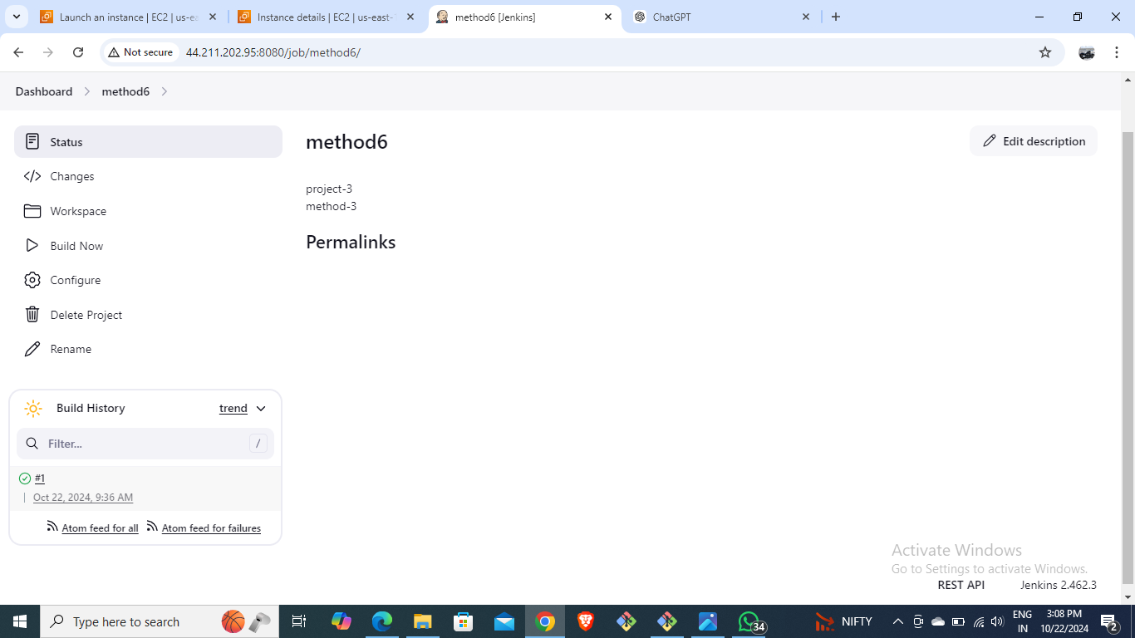
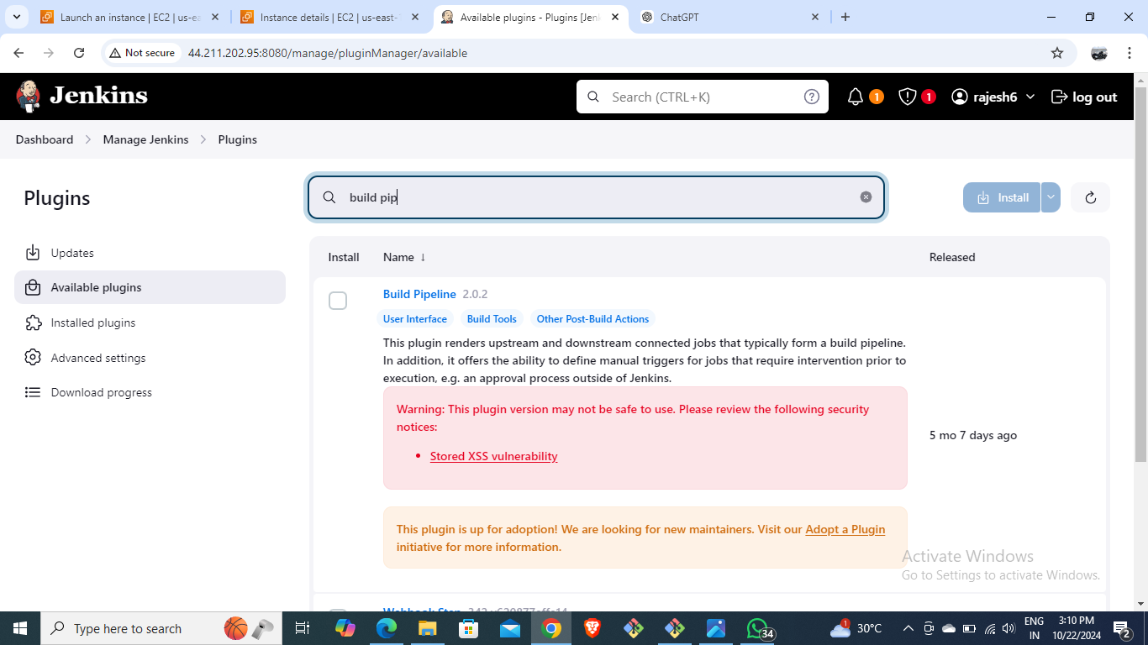
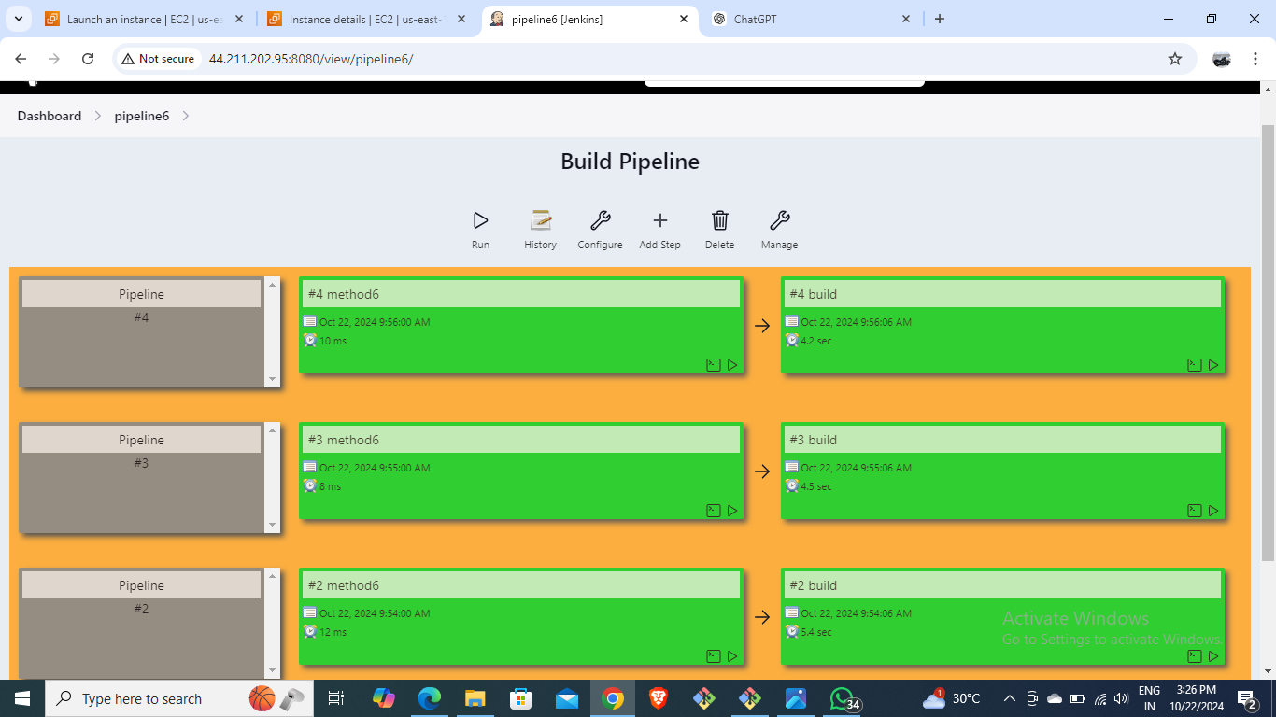
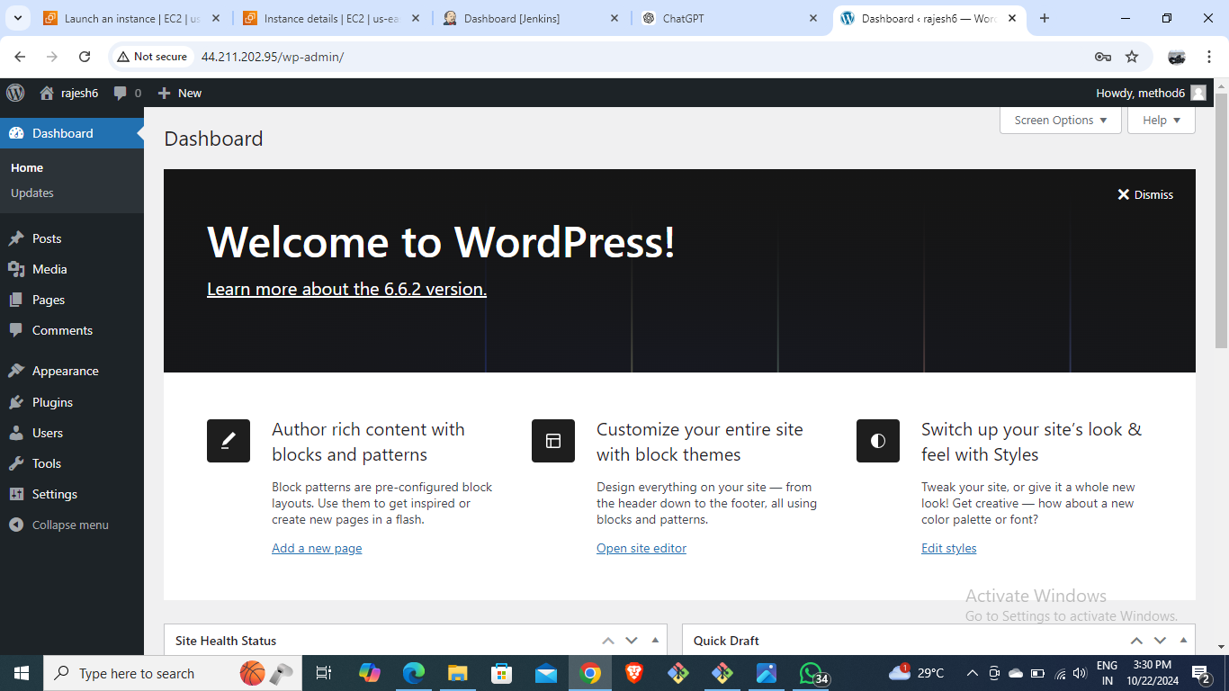

Slide 14
Using Terraform for WordPress Deployment and also with execute shell:
METHOD-7
Create Terraform scripts to define EC2, VPC, Security Groups
Run Terraform commands: init, validate, plan, apply
Automate infrastructure provisioning

Slide 15
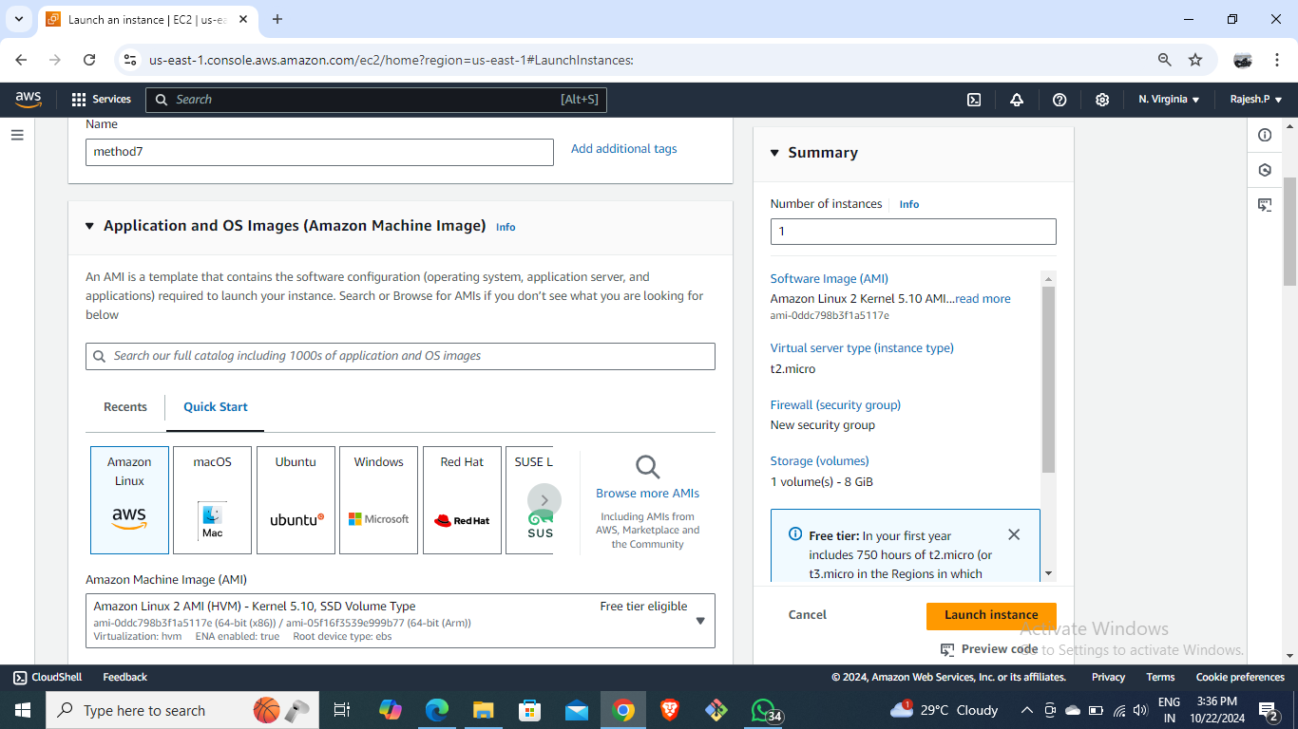
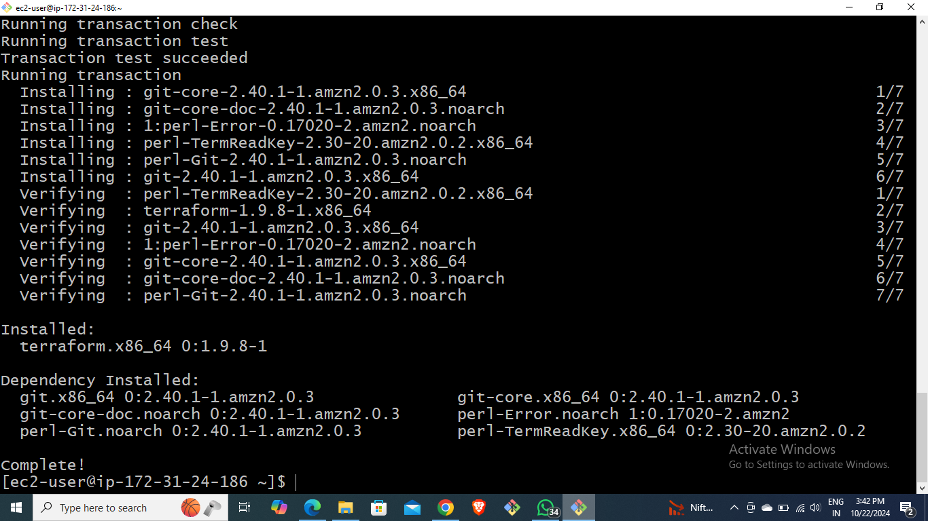
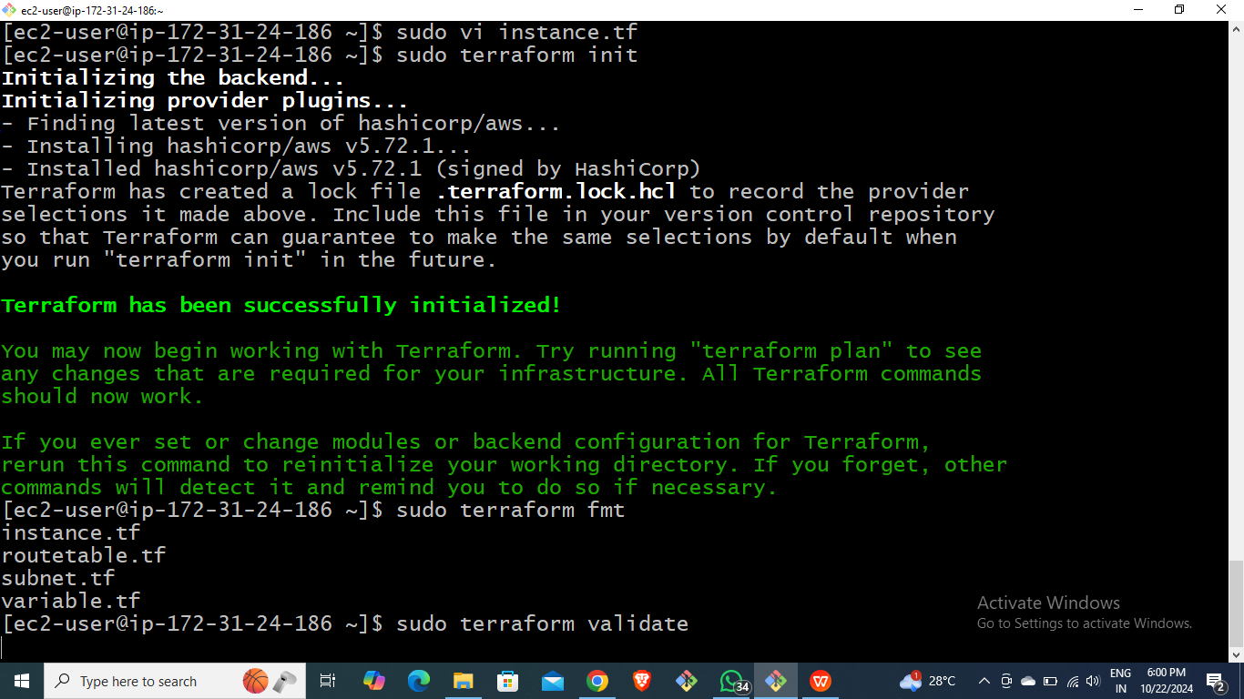
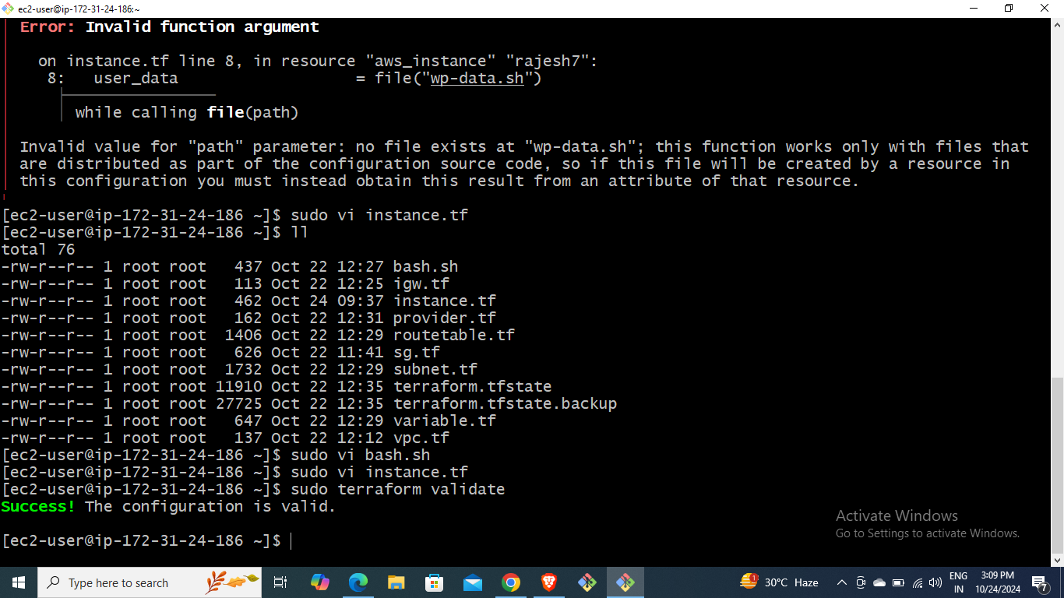
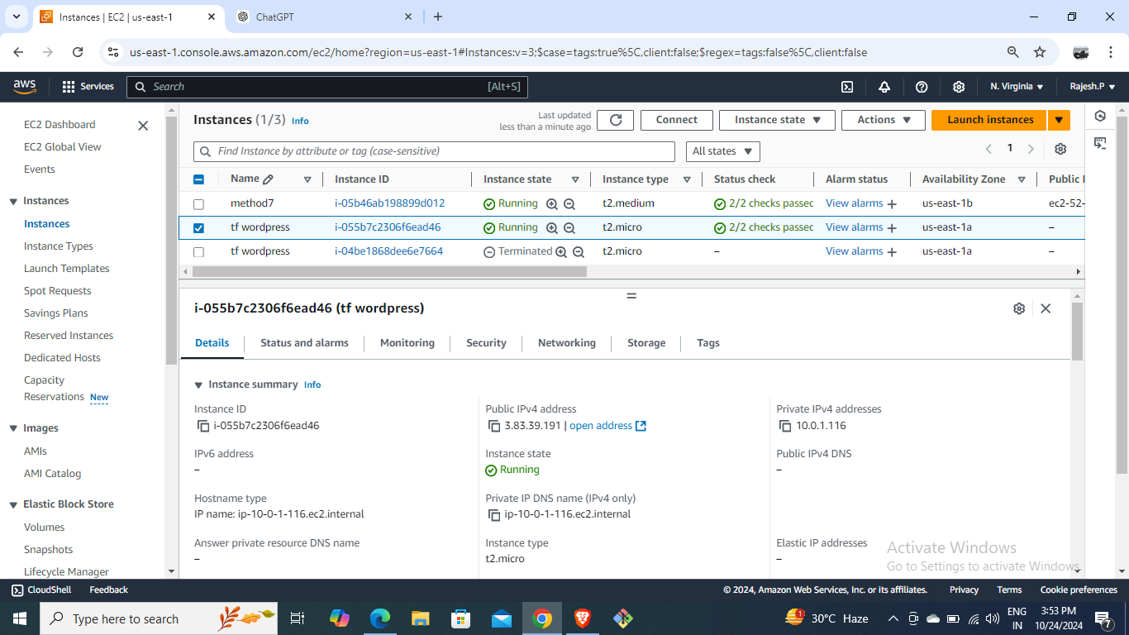
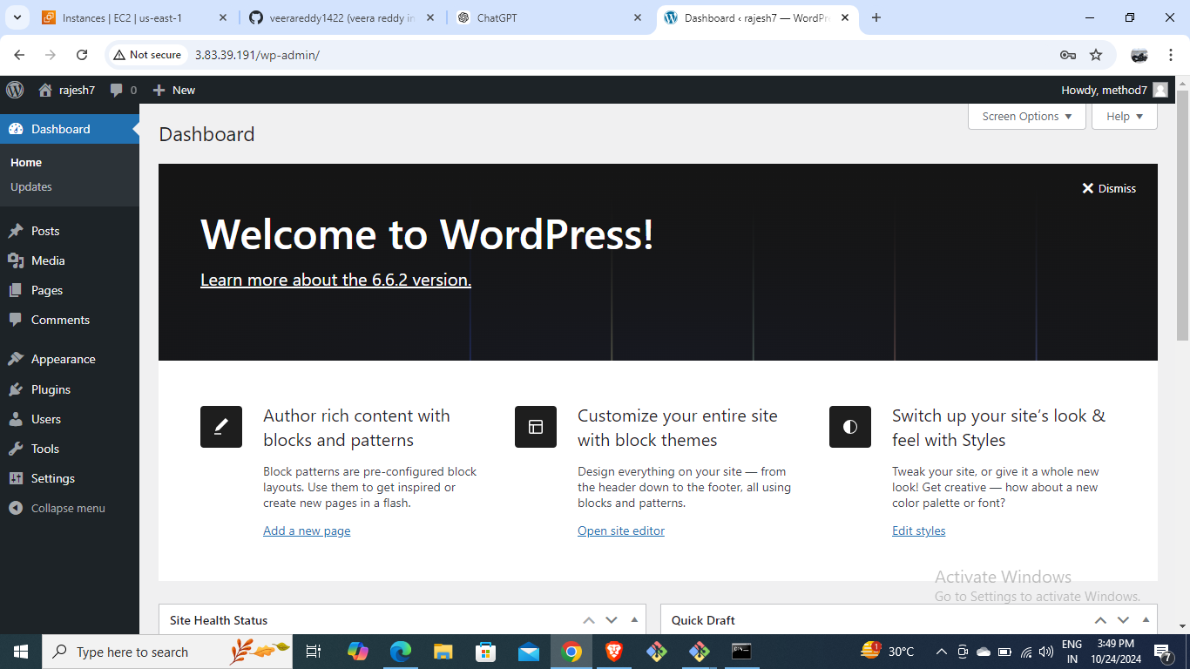

Slide 16
METHOD-8
DEPLOY WORDPRESS WEB APPLICATION BY USING GIT CLONE AND JENKINS EXECUTE SHELL INSTALL TERRAFORM, INIT, FMT, VALIDATE AND APPLY WITH AUTOMATIC COMMAND AS TERRAFORM APPLY --AUTO-APPROVE) AND TERRAFORM:
Create an instance and install git and jenkins
Open jenkins page by using public IP for an instance
create a job for cloning git repository and install terraform
Install aws credintials plug into aws acess key and secret key and then build the created job.
another instance created from terraform and browse public ip to view wordpress application.

Slide 17
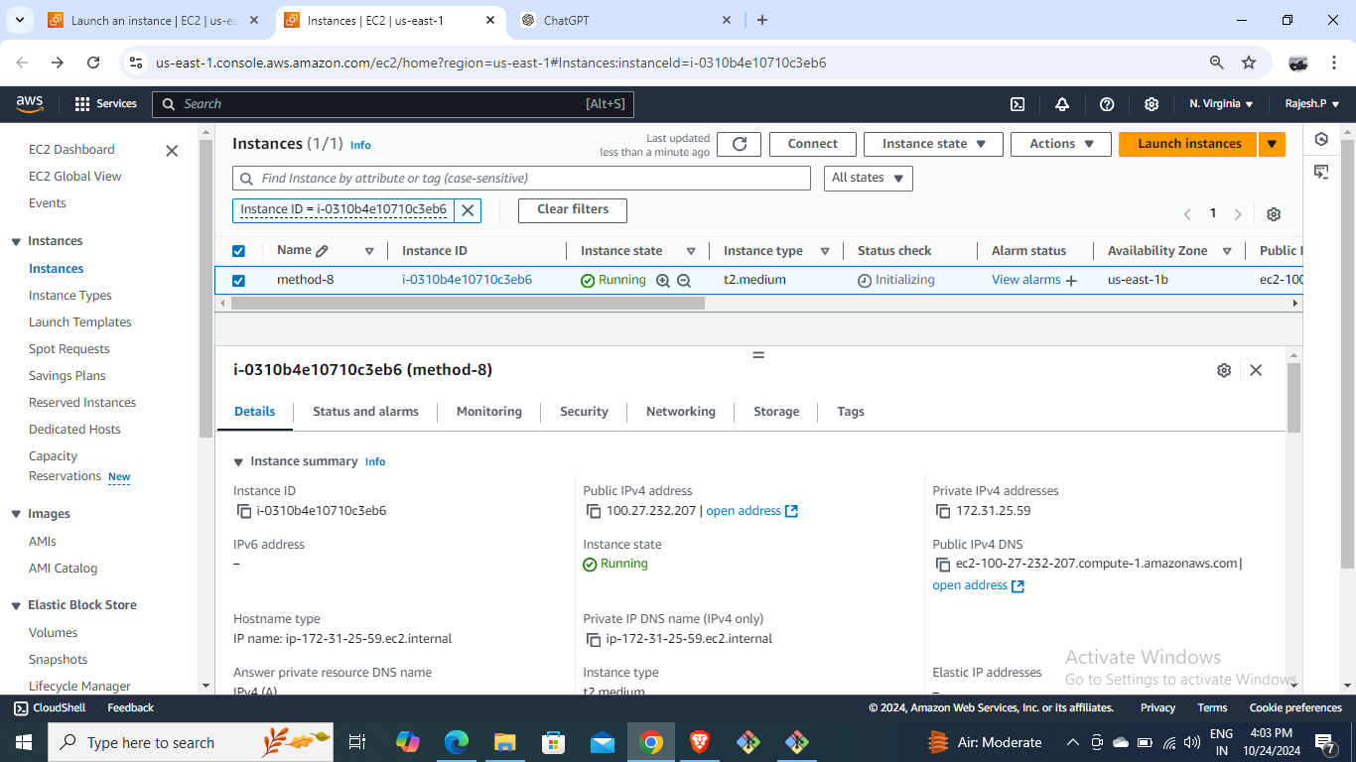
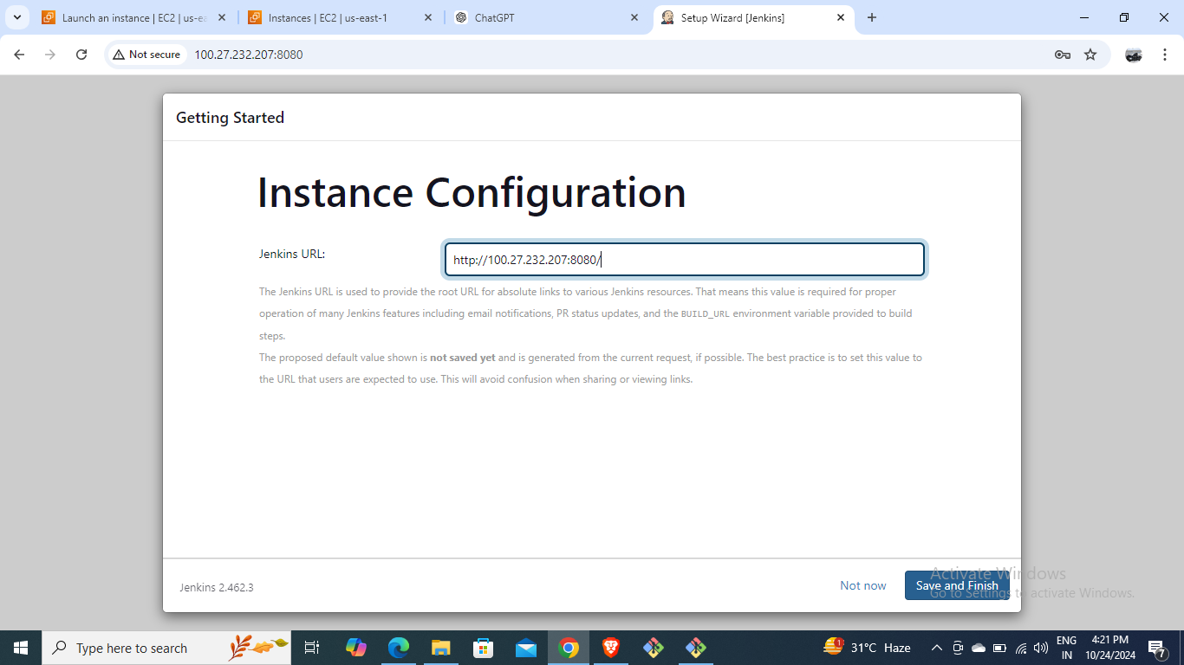
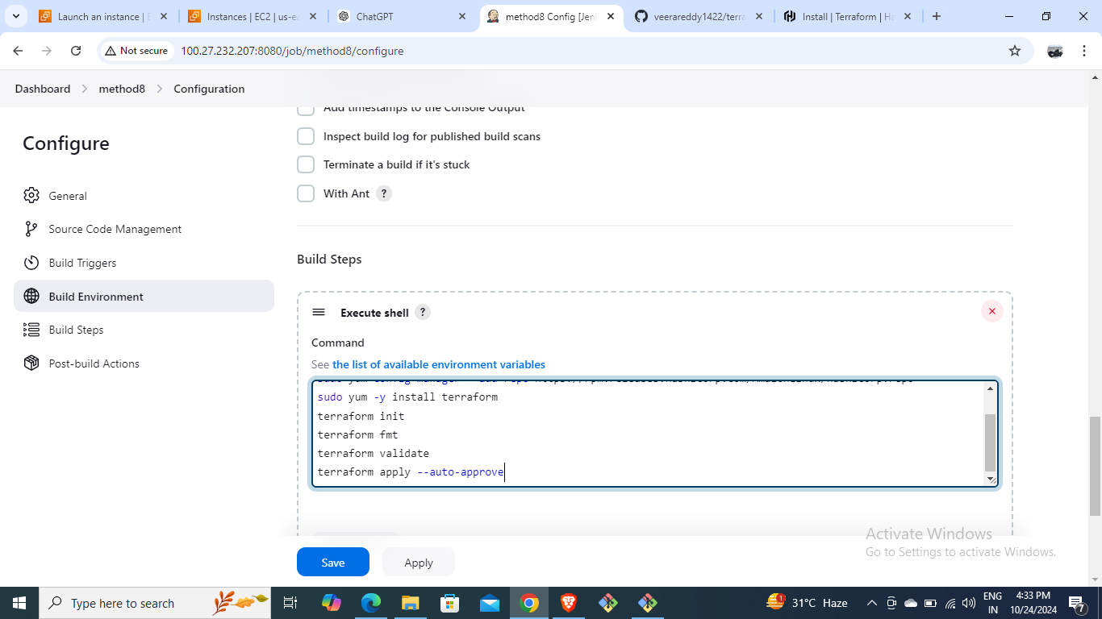
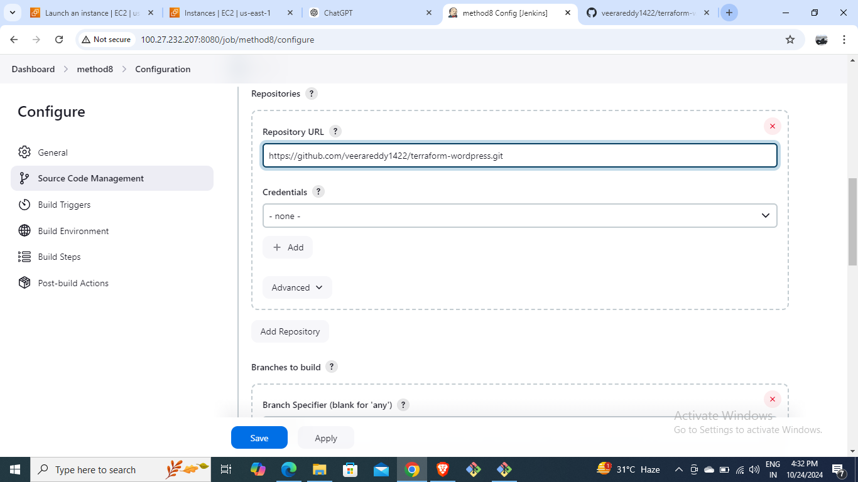
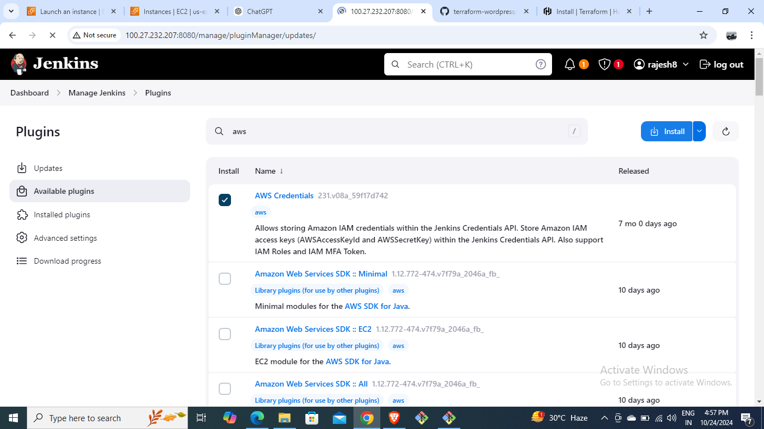
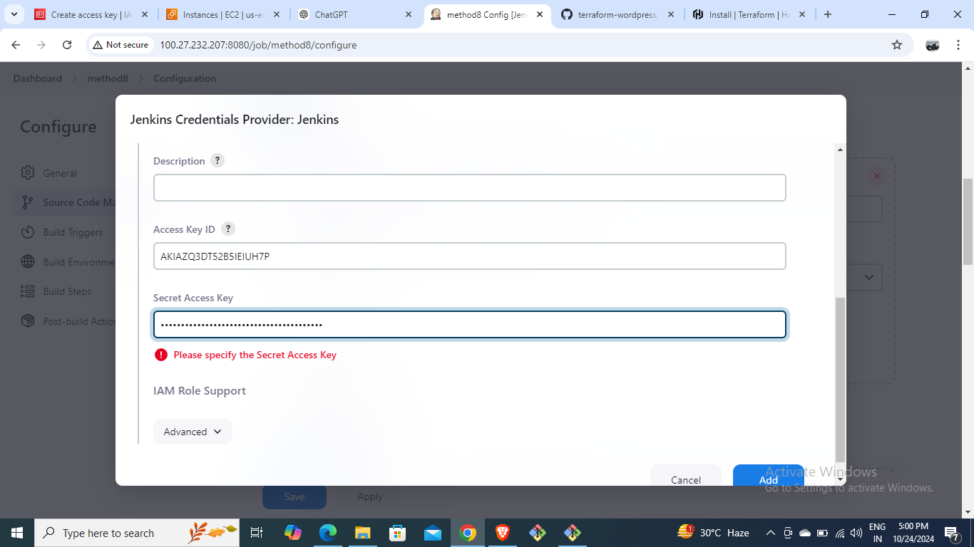
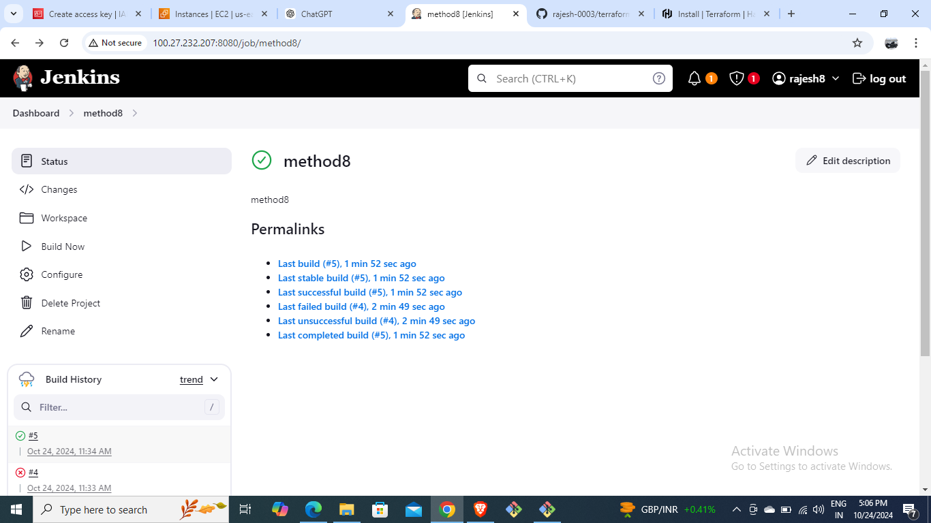


Slide 18
Jenkins Pipeline for WordPress Deployment,buildperiodically and poll scm with Git and with terraform:
METHOD-9
Set up Jenkins Pipeline with Git
Use build periodically and poll SCM for automation
Deploy WordPress using Jenkins Pipeline

Slide 19
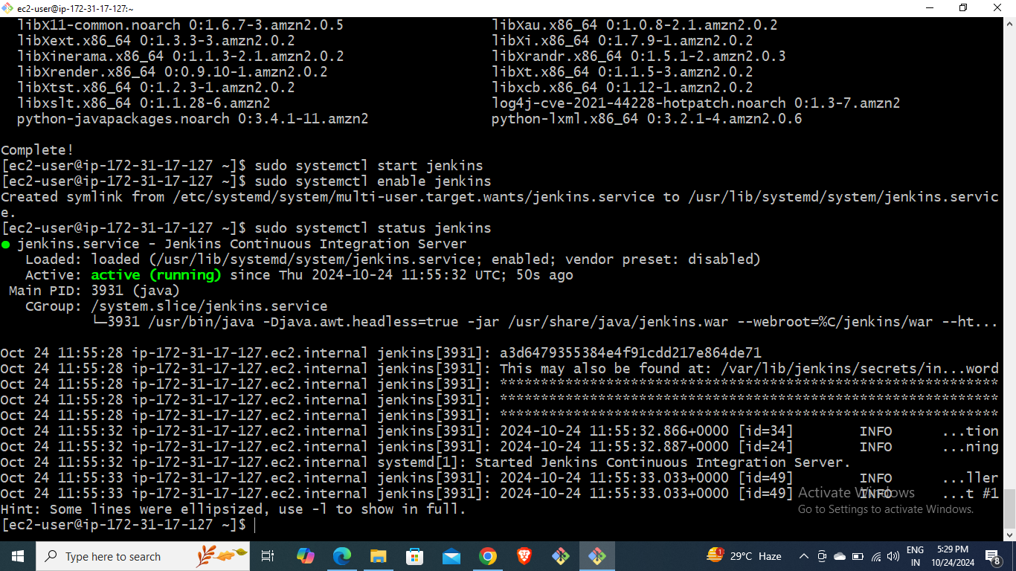
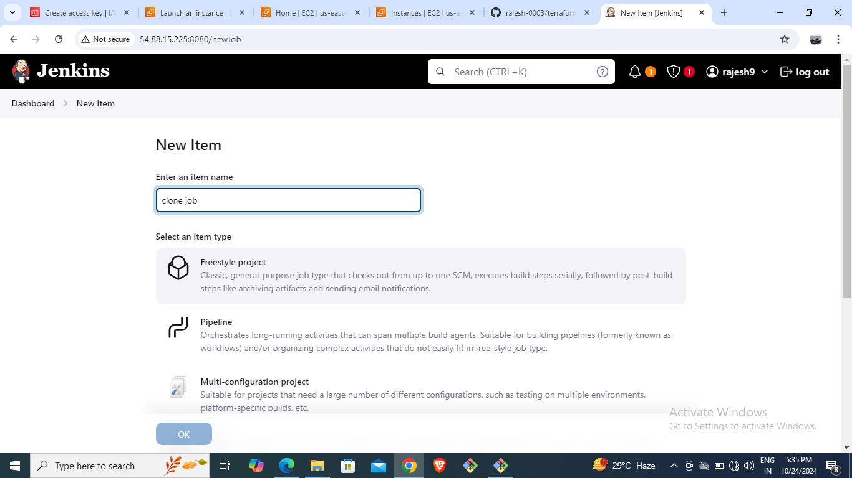







Slide 20
Deploying WordPress on Kubernetes:
METHOD-10
Kubernetes-based WordPress Deployment:
Create EC2 instances for Docker and Kubernetes
Install Kubernetes (kubectl) and Kops
Create YAML files for deployment and services

Slide 21









Slide 22
Conclusion
Summary of deployment methods:
AWS RDS and EC2 for manual setup
Docker for containerized deployment
Jenkins and Git for automated deployment
Terraform for infrastructure automation
Kubernetes for scalable deployment

Slide 23
THANK YOU
By
Rajesh Pattapu

